Slide 1

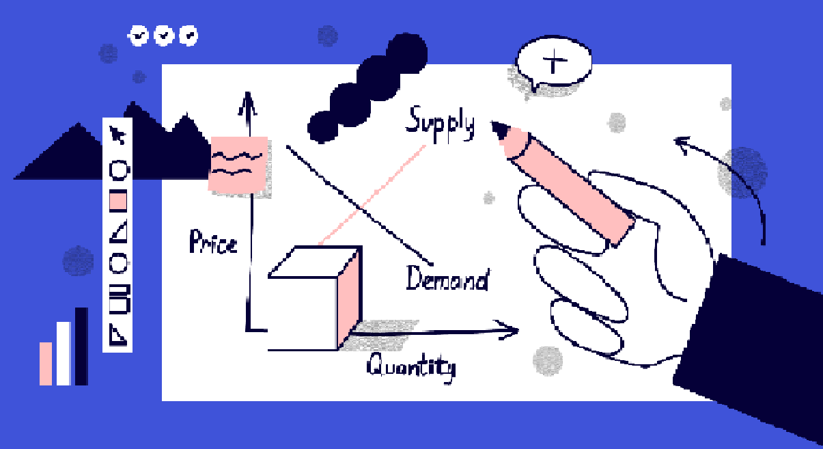
DEMAND, SUPPLY AND DETERMINATION OF PRICE
Meaning and Concept

Slide 2


Slide 3
Types of Demand
Market or individual demand: Here, the individual demand is defined as the demand for products or services by an individual consumer. The market demand can be defined as a demand for a product made by a bunch of consumers who buy that product. Therefore, it is a collective demand of each individual’s demand.
Derived demand: The derived demand is defined when the goods manufactured are related to the demand for other products . For example, the demand for silk yarn is the result of the demand for silk cloth. However, the direct demand for goods can be defined when the demand for a product is independent. For example, there is an autonomous demand for cotton cloth.
Price demand: The price demand refers to the number of goods or services an individual is eager to buy at a given price.
Income demand: The income demand means the eagerness of a person to buy a definite quantity at a given income level.

Slide 4
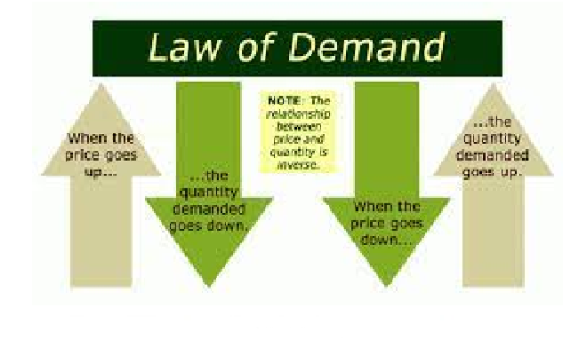
LAW OF DEMAND
MEANING - In microeconomics, the law of demand is a fundamental principle which states that there is an inverse relationship between price and quantity demanded. In other words, "conditional on all else being equal, as the price of a good increases (↑), quantity demanded will decrease (↓); conversely, as the price of a good decreases (↓), quantity demanded will increase (↑)". The law of demand is represented by a graph called the demand curve, with quantity demanded on the x-axis and price on the y-axis. Demand curves are downward sloping by definition of the law of demand.

Slide 5
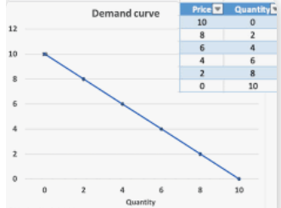

Slide 6


Slide 7
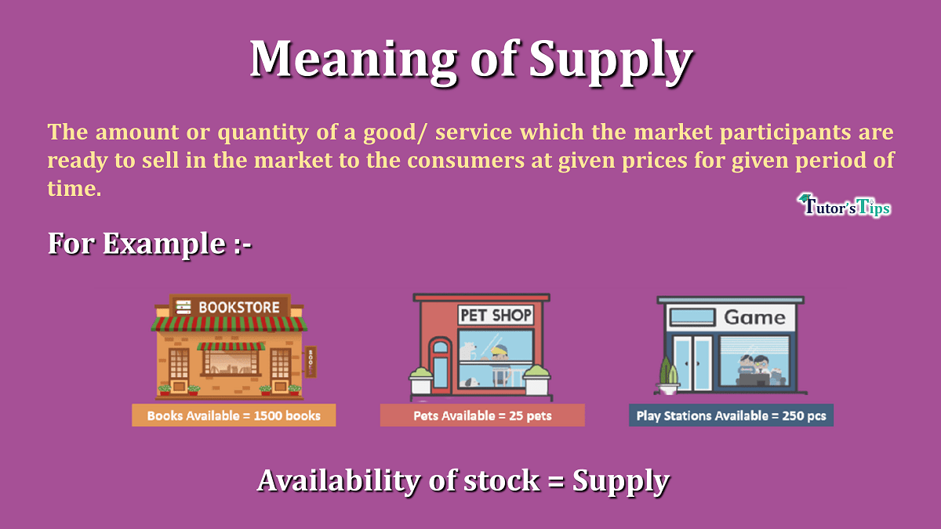

Slide 8
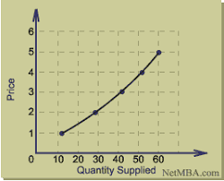
SUPPLY CURVE

Slide 9
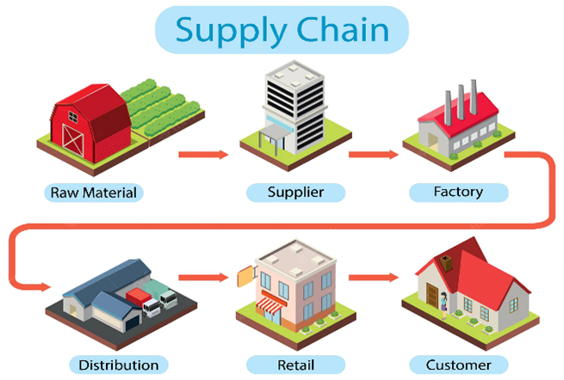

Slide 10
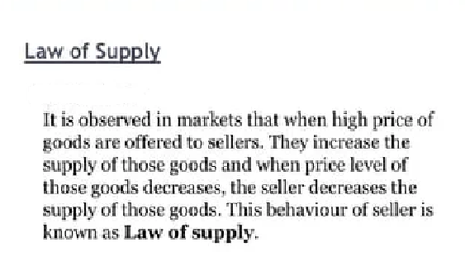
“
”

Slide 11
DETERMINATION OF PRICE

Slide 12
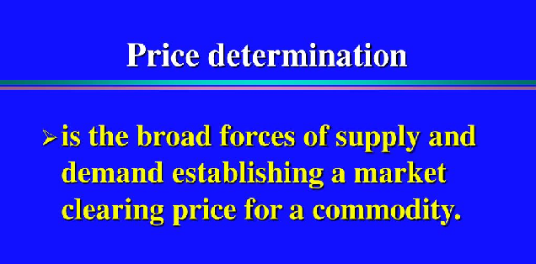

Slide 13
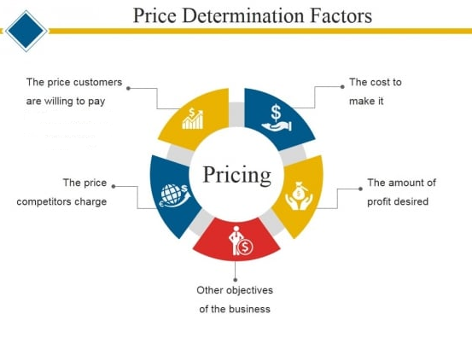

Slide 14
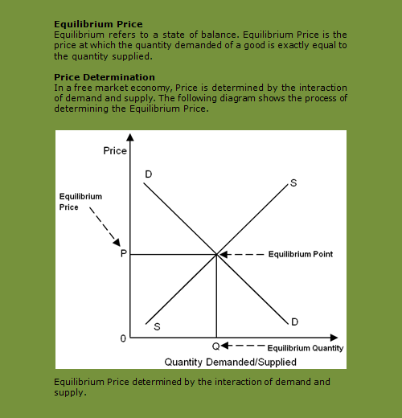

Slide 15
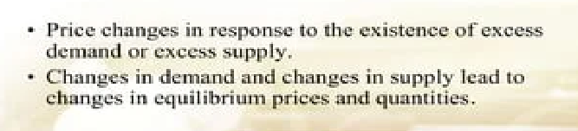
Conclusion

